Slide 1
Academy of Management PowerPoint Template
Brand elements included

Slide 2

How to use this template
Download AOM fonts onto your computer from the branding kit
This template should be saved locally on your computer
Some slides are filled out as an example, you may customize these slides directly
To add new slides with more AOM layouts, select “New Slide” and select the layout you want
To change the layout of an existing slide, select “Layout”

Slide 3
PowerPoint Tips
One core idea per slide
5-5-5 Guideline
  No more than 5 words per line, 5 lines per slide, or 5 text-heavy slides in a row
16pt+ Fonts
Prioritize visual aids over text
  Avoid data tables, use charts
  Add stock photos by going to Insert> Pictures > Stock Images
  Add Icons: Navigate to Insert > Icons

Slide 4
Icons - White

Slide 5
Icons - Color

Slide 6














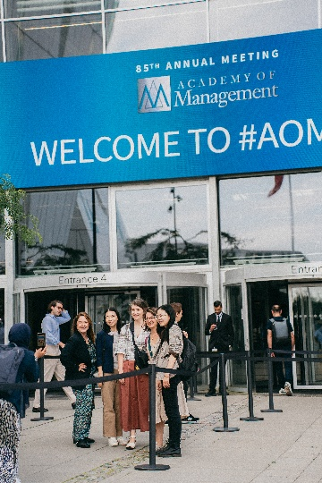




Images

Slide 7

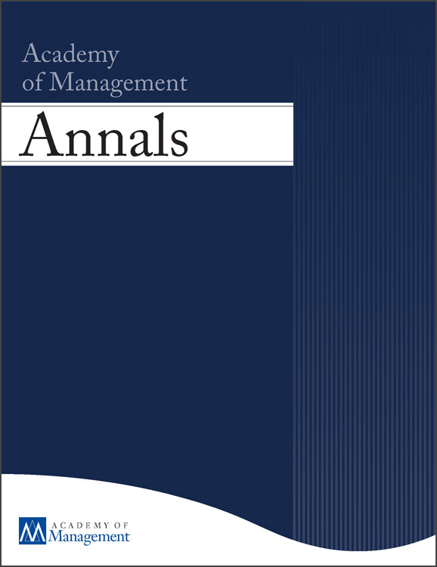
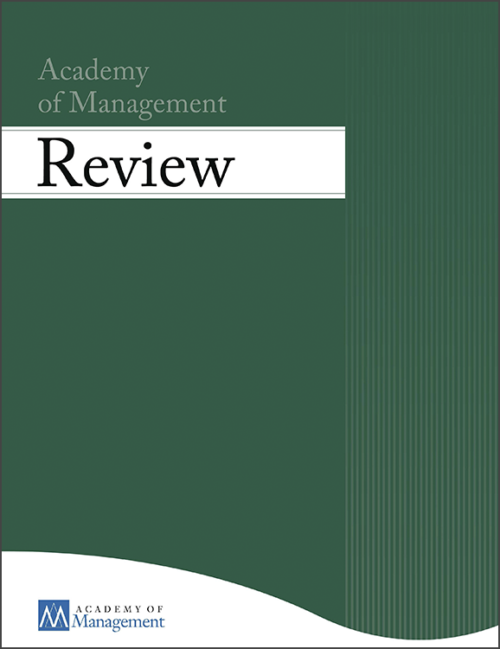


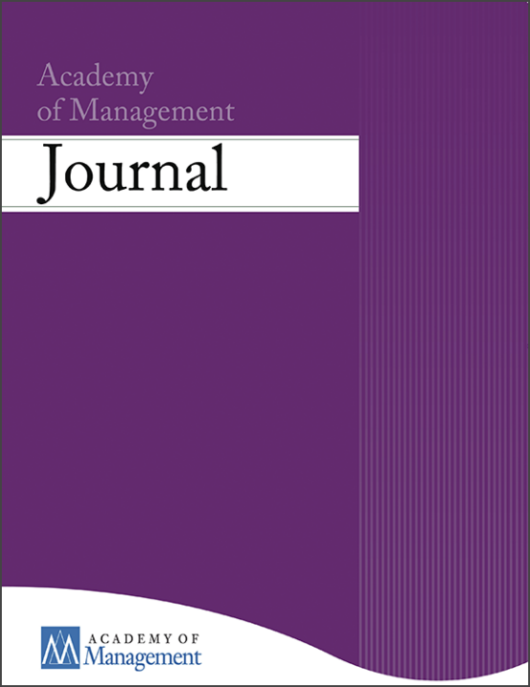
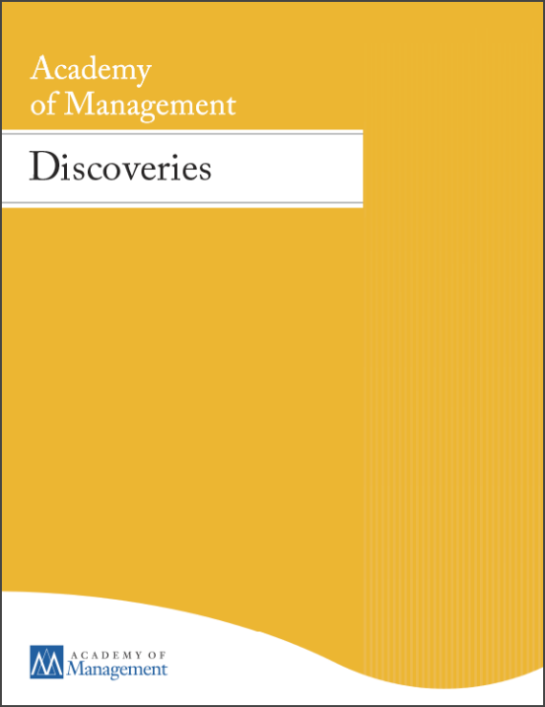
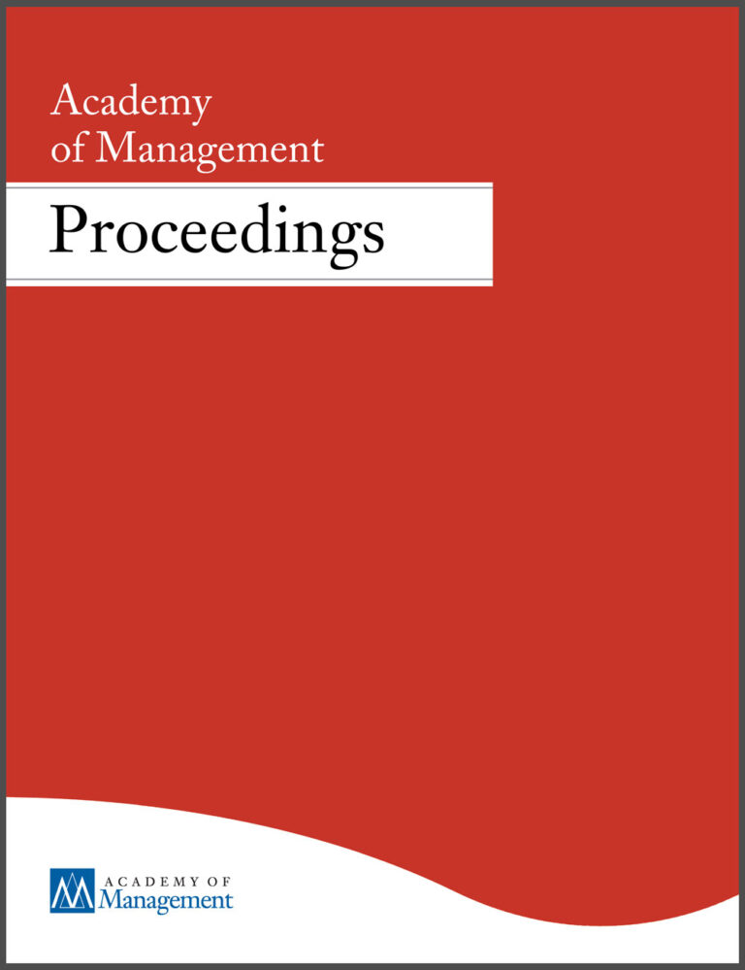
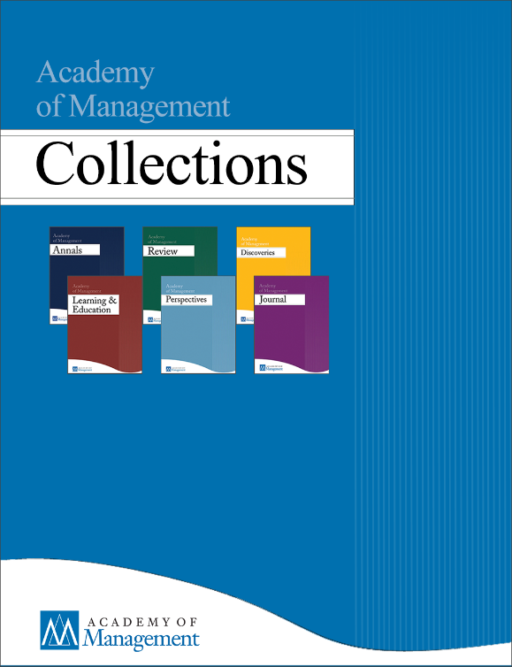

Journal Covers

Slide 8













AOM Logos - Dark

Slide 9







AOM Logos - Light

Slide 10
Title Example
Subtitle Example

Slide 11
Agenda Example
Agenda Item
Agenda Item
Agenda Item

Slide 12

Insert Title
The Academy of Management (AOM) is the leading professional association for management and organization scholars. With over 22,000 members across 110 countries, our community includes professors, doctoral students, and practitioners advancing knowledge and its real-world impact.

Slide 13

Mission
To build a vibrant and supportive community of scholars by markedly expanding opportunities to connect and explore ideas​.
Vision
We inspire and enable a better world through our scholarship and teaching about management and organizations.​

Slide 14

Values
  We value high quality research, teaching, and practice in the field of management and organization​
  We cultivate and advocate ethical behavior in all aspects of our work​
  We provide a dynamic and supportive community for all our members, embracing the full diversity of our backgrounds and experiences​
  We respect each of our members' voices and seek to amplify their ideas​
  We build cooperative relationships with other institutions committed to the advancement of scholarship and teaching about management and organization​

Slide 15



About AOM
AOM is a community of engaged members who teach and conduct research in the area of management.
We harness the power of our global members as volunteers to advance the professional development and careers of management scholars in all stages of the academic life-cycle.​
We offer a platform for exchange around the creation and dissemination of rigorous and relevant knowledge pertaining to management scholarship, teaching, and practice.

Slide 16
22,000+
Members
7,129
Europe
8,431
North America
3,402
Asia
101
Africa
287
Central & South America
601
Australia & South Pacific
Annual Membership Count, 30 July 2025

Slide 17

Divisions & Interest Groups (DIGs)
AOM Divisions and Interest Groups encompass a diverse array of member interests spanning across 26 management domains.
Each DIG offers a range of services, including educational sessions, social events at the Annual Meeting, and DIG websites and Connect@AOM communities for sharing professional development opportunities, recognition programs, and division updates.

Slide 18
Divisions & Interest Groups (DIGS)
Careers
Communication, Digital Technology, and Organization
Conflict Management
Critical Management Studies
Diversity, Equity, and Inclusion
Entrepreneurship
Health Care Management
Human Resources
International Management
Management Consulting
Management Education and Development
Management History
Management, Spirituality, and Religion
Managerial and Organizational Cognition
Operations and Supply Chain Management
Organization and Management Theory
Organization Development and Change
Organizational Behavior
Organizational Neuroscience and Biology
Organizations and the Natural Environment
Public and Nonprofit
Research Methods
Social Issues in Management
Strategic Management
Strategizing Activities and Practices
Technology and Innovation Management

Slide 19

What Is CAP?
AOM’s global initiative to expand access, strengthen partnerships, and amplify scholarship for scholars in underrepresented regions.
Our Purpose
  Build trusted relationships with universities, associations, and other stakeholders worldwide
  Equip and support scholars with tools, training, and visibility
  Connect local research with AOM’s global community of practice

Slide 20
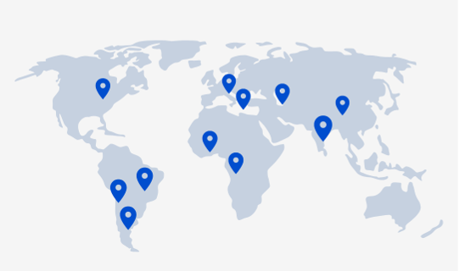
Quote slide example
Quote quote quote
-Quote by

Slide 21
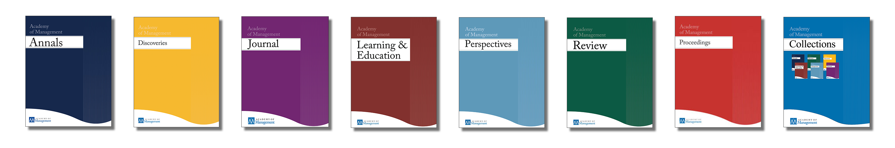



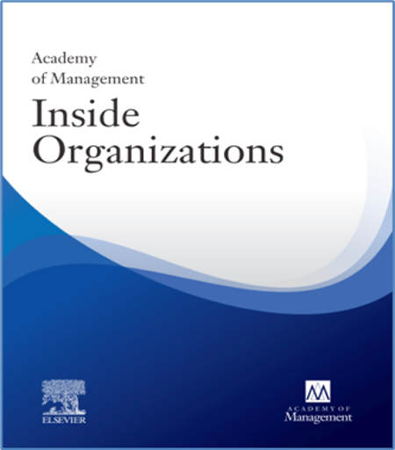
Publications
AOM publishes seven journals, an annual meeting proceedings publication, Academy of Management Insights and AOM Today. Research is published within these leading journals as well as presented at AOM events.
All articles are peer reviewed to ensure that they are verified as scientifically reliable, relevant, and adhere to AOM, academic, and industry standards.

Slide 22

AOM Member Benefits
Networking: Create your scholarly home and identity through discussions on Connect@AOM to help you expand your reach and contacts in the profession.
Research: Access the latest management and organization scholarship through AOM scholarly journals and publications.
Develop your career: Develop and expand your professional career through the DIGs, journals, events and AOM’s Career Services.
Meetings: Attend events like AOM 2025, DIG Virtual Events and Paper Development Workshops.

